Slide 1

Environmentally Responsible Product Certification
UBA2814-Professional Ethics and Legel Practices
Guided By:
T. G. Sakthivel
Presented by:
Ch. Niharika (1925260124)

Slide 2


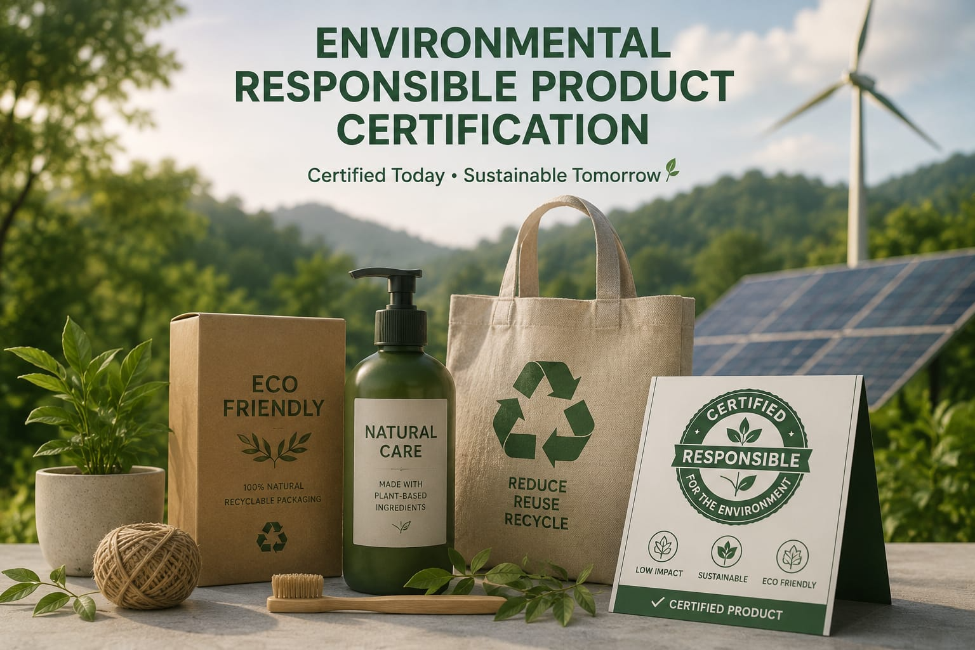
Introduction
Certification identifies environmentally responsible products
Evaluates the environmental impact of products
Promotes sustainable production practices
Helps consumers make eco-friendly choices
Supports environmental protection.

Slide 3
Need for Certification
Reduces environmental pollution
Encourages efficient use of natural resources
Minimizes waste generation
Promotes energy-efficient products
Builds consumer confidence.

Slide 4
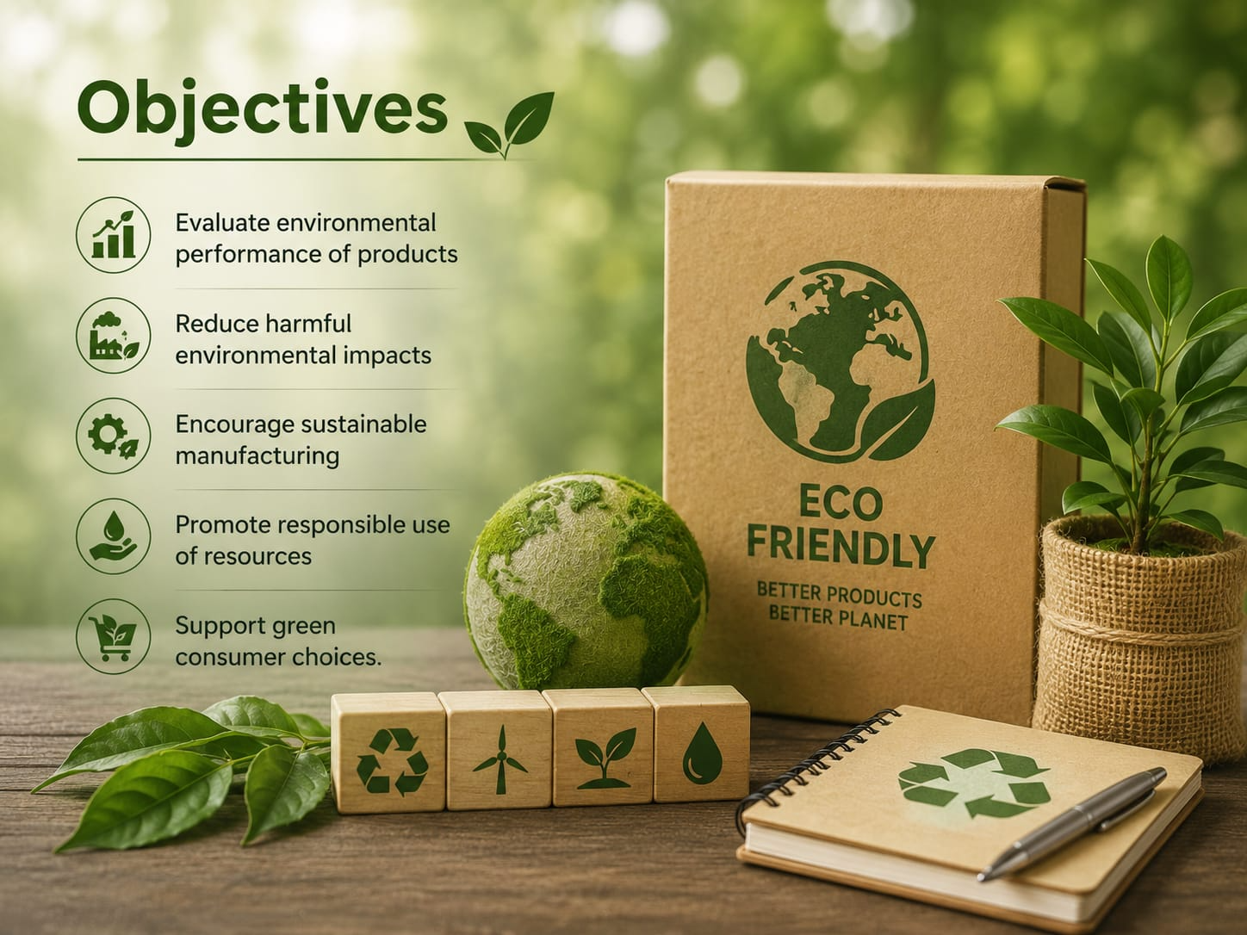
Objectives
Evaluate environmental performance of products
Reduce harmful environmental impacts
Encourage sustainable manufacturing
Promote responsible use of resources
Support green consumer choices.

Slide 5
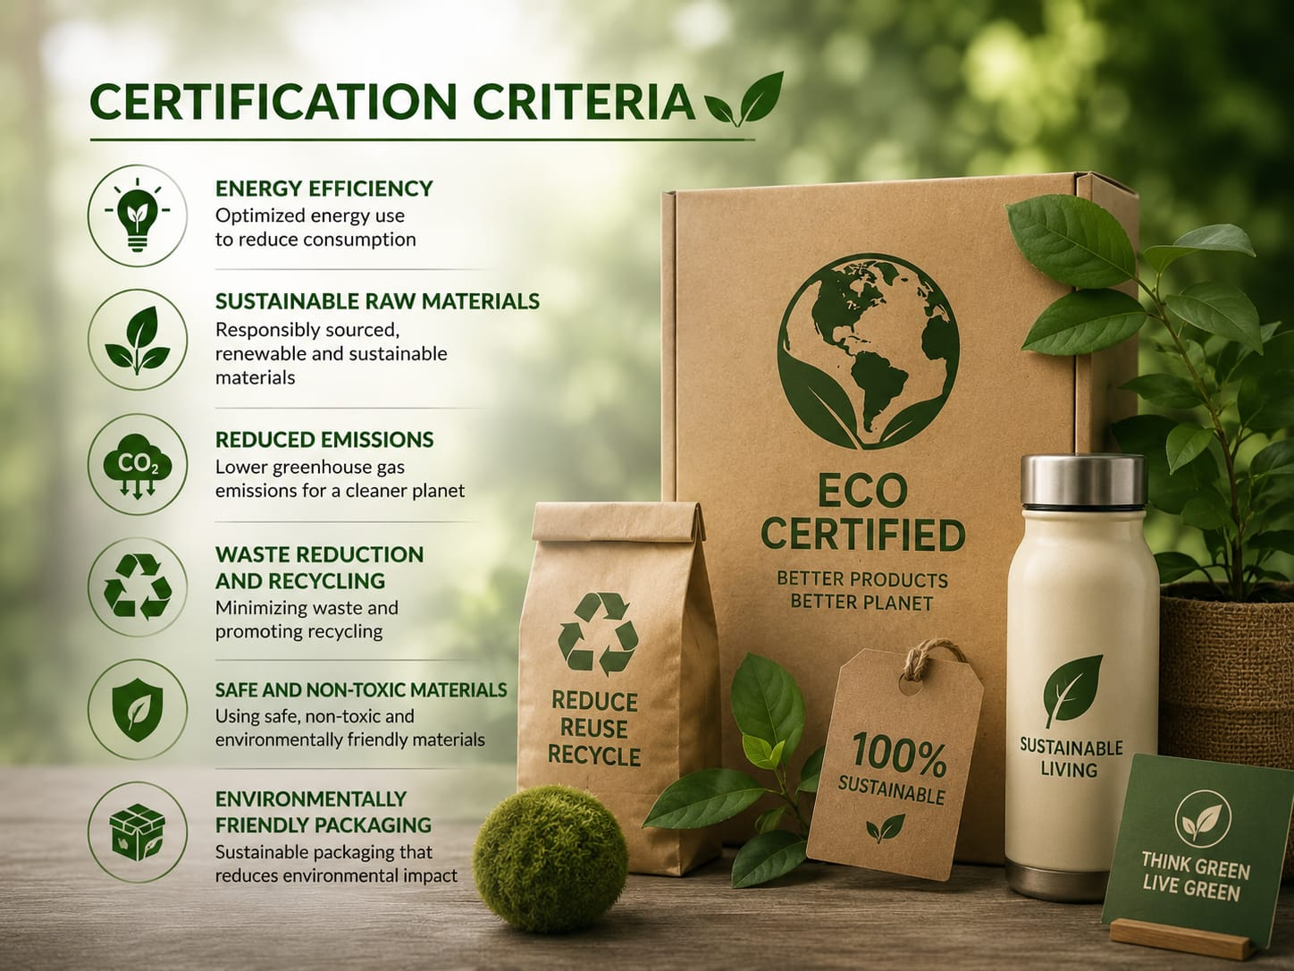
Certification Criteria
Energy efficiency
Sustainable raw materials
Reduced emissions
Waste reduction and recycling
Safe and non-toxic materials
Environmentally friendly packaging

Slide 6
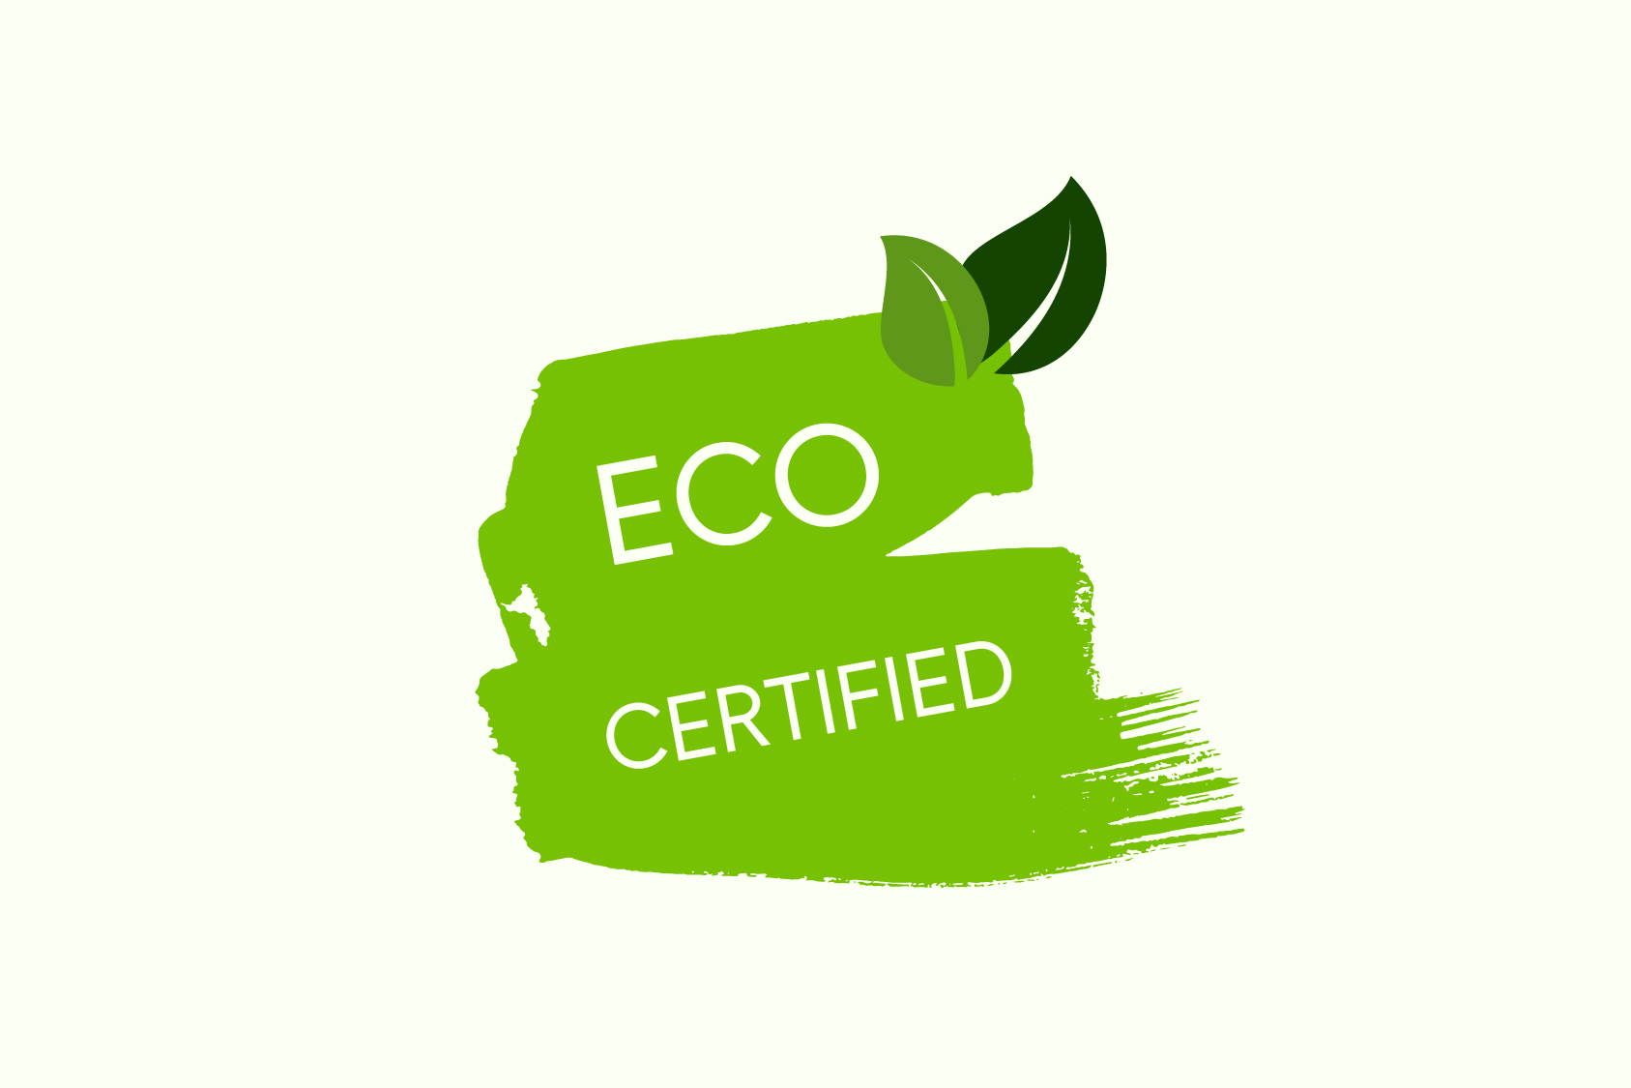
Certification Process
Identify product requirements
Collect product and manufacturing information
Conduct environmental assessment
Test and verify product performance
Review certification requirements
Issue environmental certification

Slide 7
Role of Engineering Ethics
Engineers must protect the environment
Ensure honest product evaluation
Avoid misleading environmental claims
Follow safety and environmental standards
Consider long-term environmental impacts
Maintain professional responsibility

Slide 8
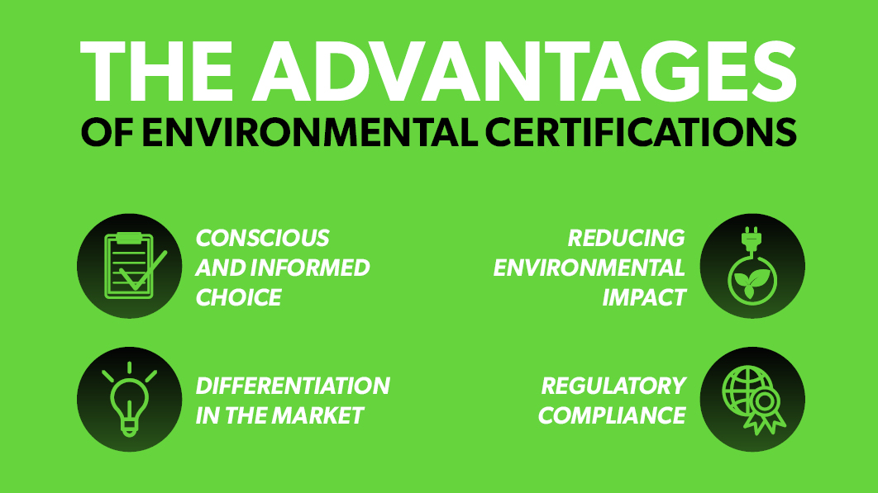
Aadvantages
Reduces environmental damage
Improves product quality
Increases customer trust
Encourages sustainable innovation
Supports resource conservation
Improves company reputation

Slide 9
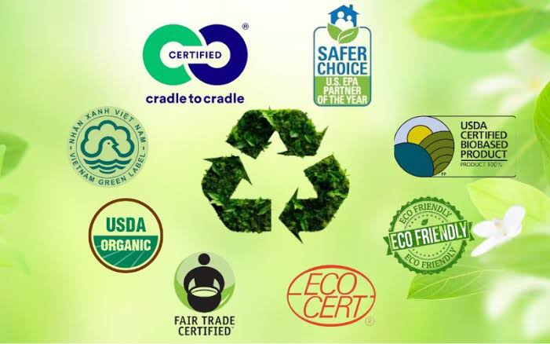
Challenges
High certification costs
Complex testing procedures
Lack of awareness among consumers
Difficulty in monitoring supply chains
Changing environmental standards
Risk of false green claims

Slide 10
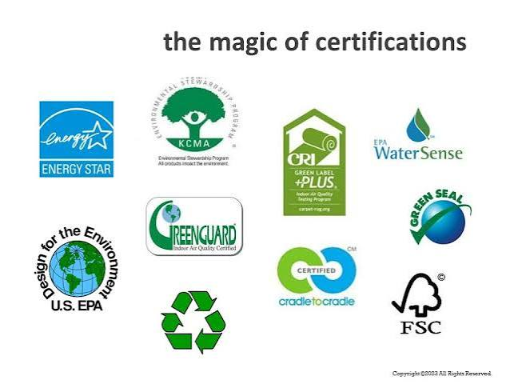
Real-Time Applications
Energy-efficient electrical appliances
Electric and hybrid vehicles
Recycled-material products
Eco-friendly construction materials
Sustainable packaging
Energy-efficient buildings

Slide 11
Future Scope
Use of AI for environmental assessment
Digital certification and tracking
Greater use of recyclable materials
Development of low-carbon products
Improved international standards
Increased consumer awareness

Slide 12
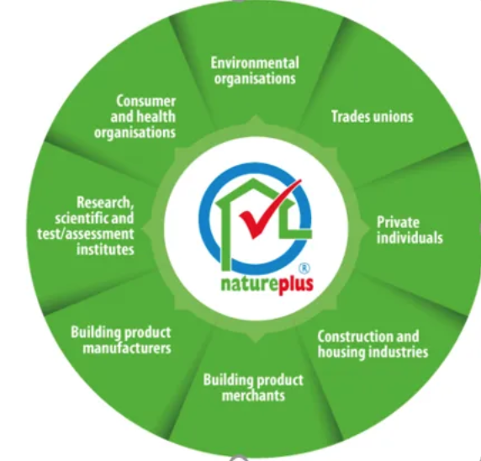
Conclusion
Certification promotes environmentally responsible products
Helps reduce environmental impact
Encourages ethical engineering practices
Supports sustainable manufacturing
Builds trust between companies and consumers
Contributes to a greener future

Slide 13
References
International Organization for Standardization (ISO) – Environmental Management Standards
ISO 14001 – Environmental Management Systems
ISO 14020 Series – Environmental Labels and Declarations
U.S. Environmental Protection Agency (EPA) – Sustainable Manufacturing
United Nations Environment Programme (UNEP) – Sustainable Consumption and Production
Global Ecolabelling Network (GEN) – Environmental Certification
European Commission – EU Ecolabel
World Business Council for Sustainable Development (WBCSD) – Sustainable Products and Manufacturing

Slide 14
Thank You

